Slide 1
Alternative Development
Policies, commitments & political framework conditions
Alexander Seger
at
UN Commission on Narcotic Drugs
Vienna, 17 April 2003

Slide 2
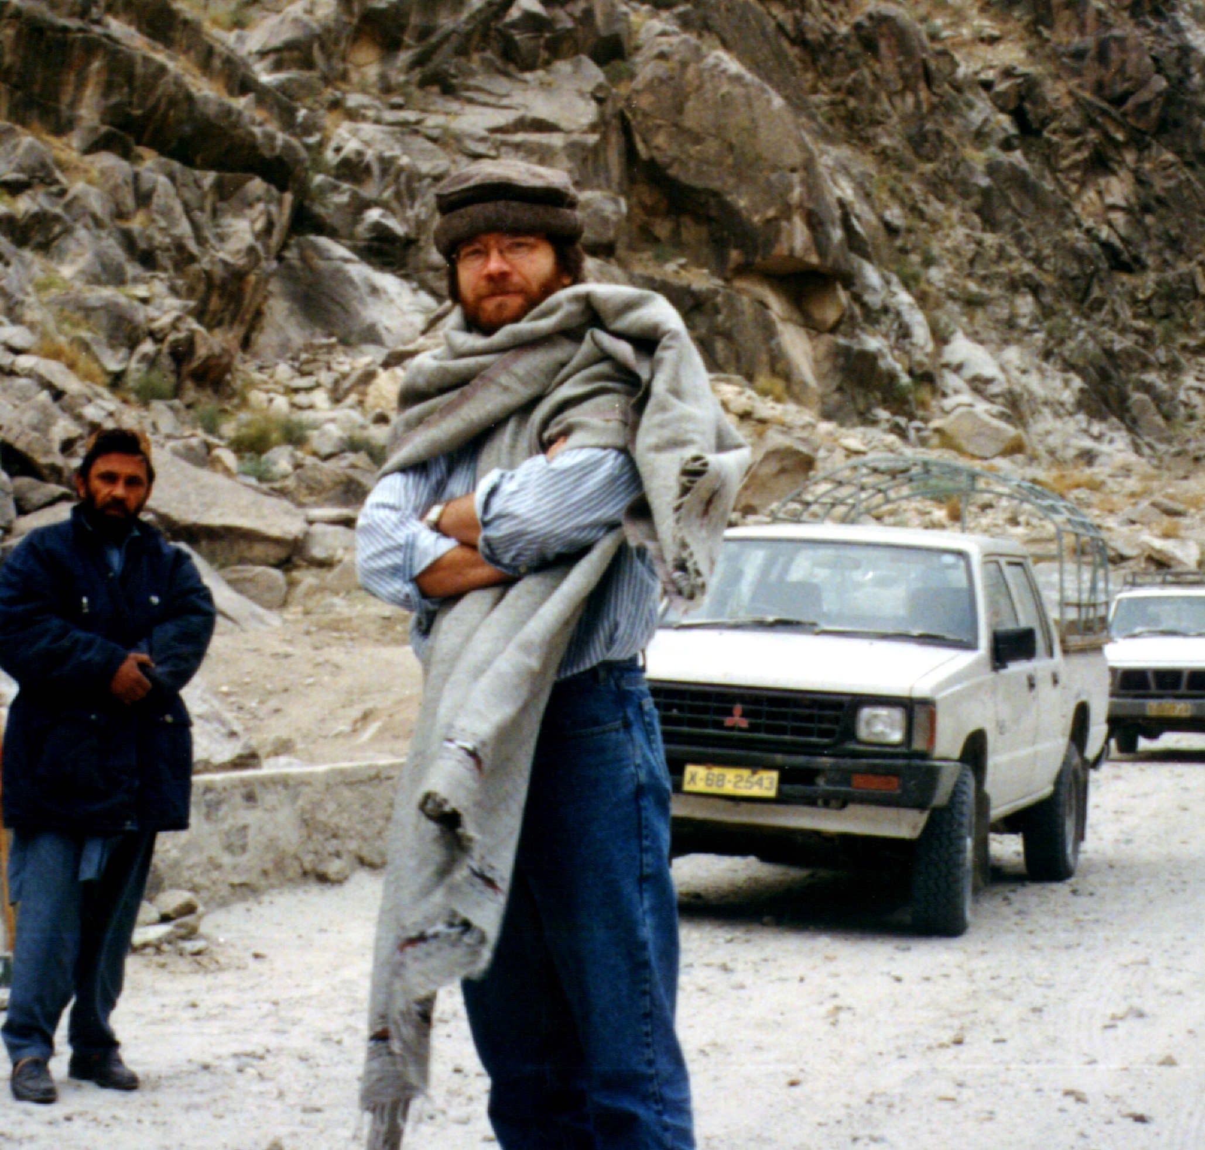
Alexander Seger,
Drug controller (rtd)
Drug controller .
?
2
2

Slide 3
Policies
1
Pursue a balanced approach
(UNGASS Action Plan)
Reducing demand
Reducing supply
Controlling processing and trafficking
Reducing cultivation
Law enforcement (incl eradication of crops)
Alternative development
3

Slide 4

..... reducing cultivation through alternative development and law enforcement, including eradication
Design approaches adapted to local circumstances based on three elements:
3. Eradication of narcotic crops
2. Law enforcement against trafficking
1. Dialogue, persuasion and community-based agreements
4
4

Slide 5
2
Make sustainable human development the goal of drug control
3
Link up drug control and other development strategies
integration
mainstreaming
synergies
conditionality
5

Slide 6

The rationale of drug control
Objectives: peace, human rights and sustainable human development
contribute to
contribute to
Development strategies
reinforce each other
Drug control strategies
or can exacerbate
require
require
Development problems
reinforce each other
Drug problems
6
6

Slide 7
4
Promote alternative development
UNGASS Action Plan “E” (1998)
Feldafing Declaration (2002)
1988 Convention (art 14)
... a process to prevent and eliminate the illicit cultivation of plants containing narcotic drugs and psychotropic substances through specifically designed rural development measures ...
30+ years of experience
7

Slide 8

Commitments
“The international community .... should assist States in countering illicit drug production by providing adequate financial and technical assistance for alternative development. ... Such assistance should be provided within the context of national control strategies of the recipient States. It should be linked to national commitment and the strong political will of States with illicit cultivation to implement the provisions contained in article 14 of the 1988 convention” (UNGASS Action Plan, para 9).
8

Slide 9
Political commitment by the international community and national governments
5
Turn commitments into action
9
9

Slide 10
6
Governments should formulate and implement national drug control policies (“balanced approach”)
7
International community should provide support
10

Slide 11
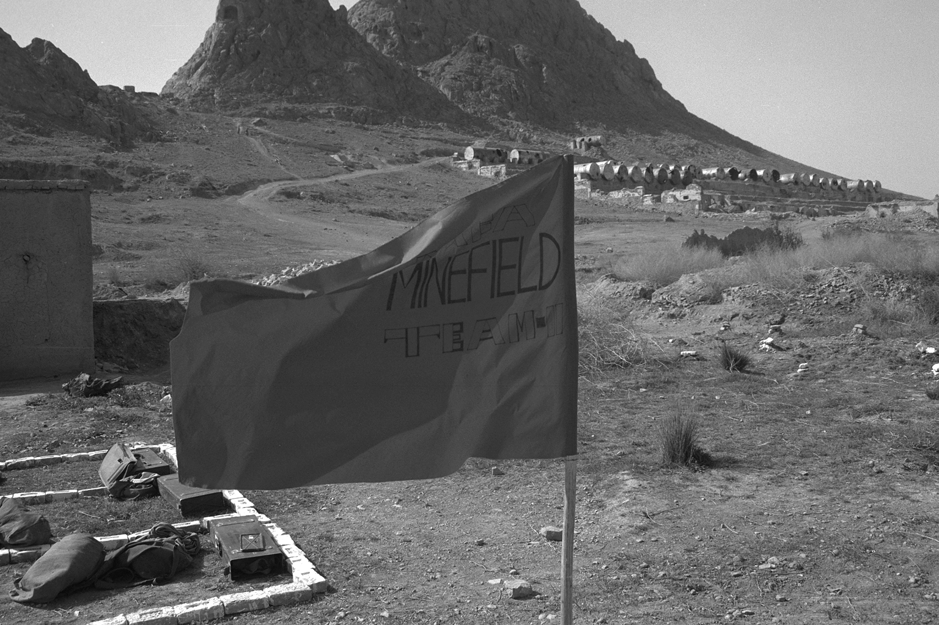
8
National authorities need to make every effort to establish the necessary political framework conditions for drug control and sustainable human development
Pre-condition or inter-related process?
11

Slide 12
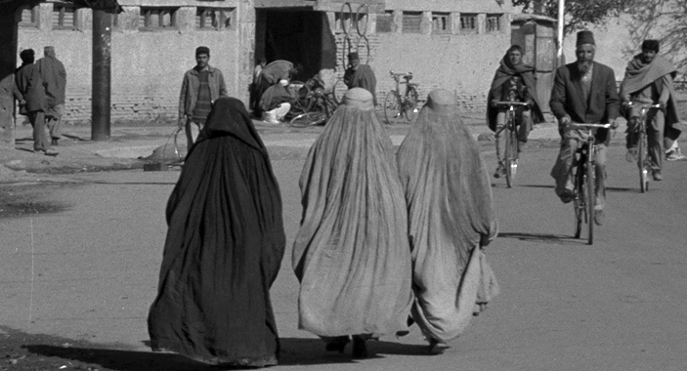
What are ”political framework conditions”?
Human rights + democratic governance
Political framework conditions =
the extent to which human rights are protected and democratic governance is exercised
12

Slide 13
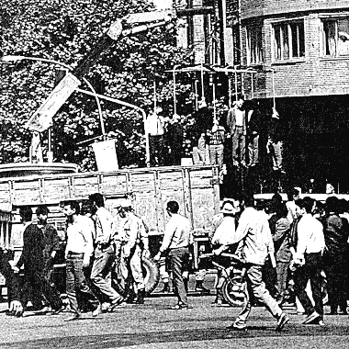
Human rights
”... the fight against illicit drugs must be pursued in accordance with .... all human rights and fundamental freedoms” (UNGASS Action Plan)
13

Slide 14
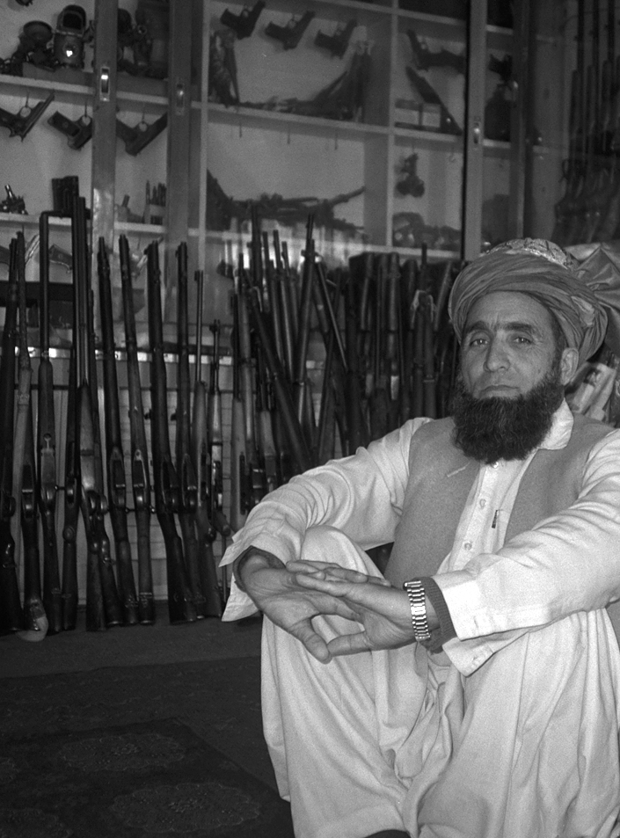
Democratic governance
rule of law
participation, equity, democracy
effectiveness and efficiency
transparency and accountability
14

Slide 15
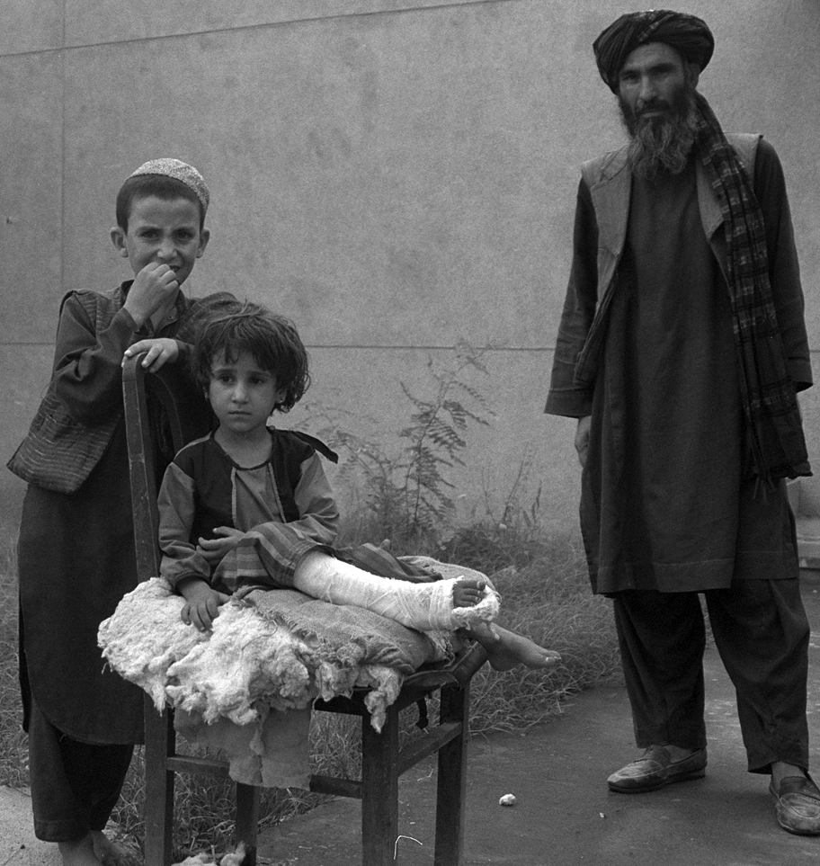
9
Use the alternative development process to support the protection of human rights and democratic governance
15

Slide 16
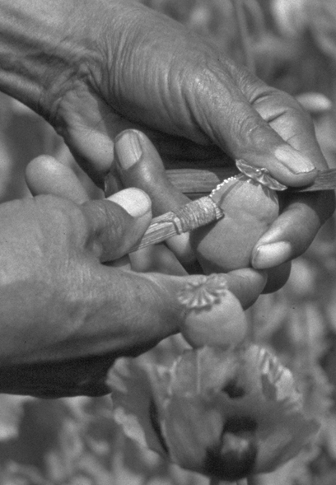
10
Make support to alternative development conditional to commitment to drug control, human rights and democratic governance
16

